Slide 1
Cluster Analysis from MFA
Completes Cases (FULL=110) Vs Imputed Observations (147 -110)

Slide 2
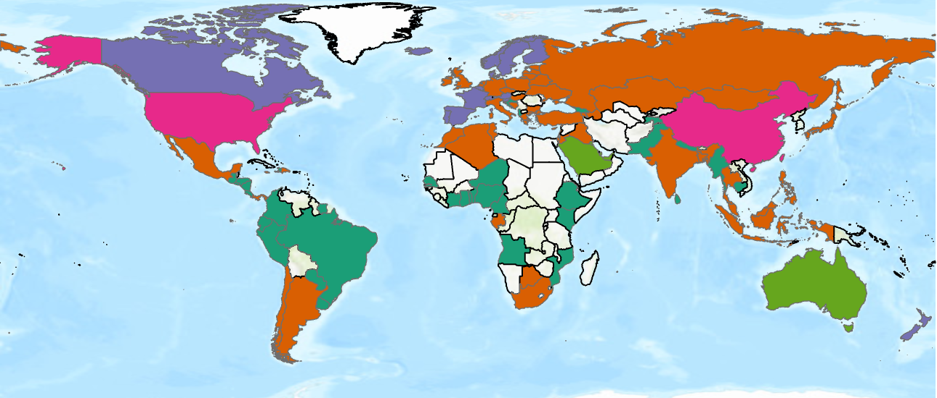
Complete Cases

Slide 3
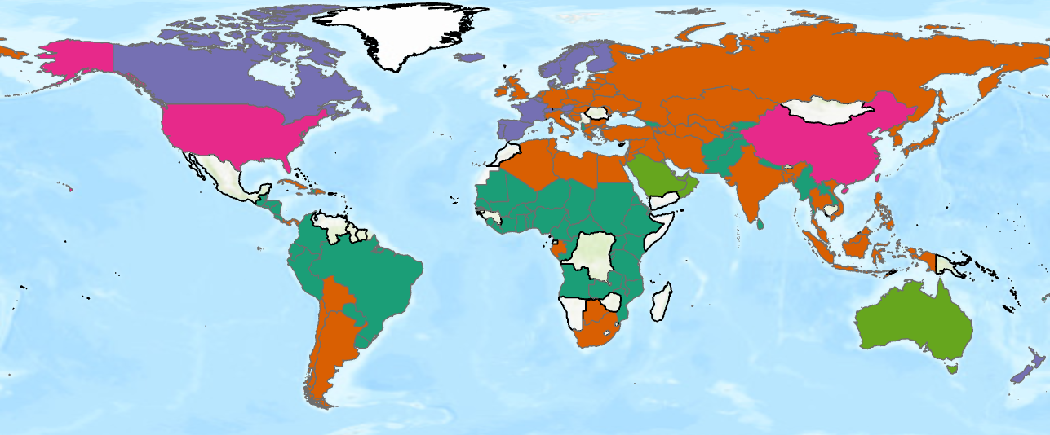
Imputed Observations

Slide 4
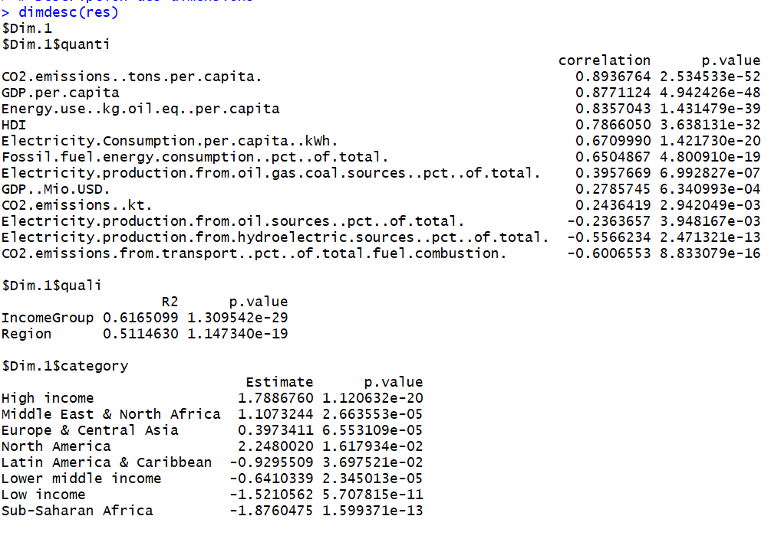

Slide 5
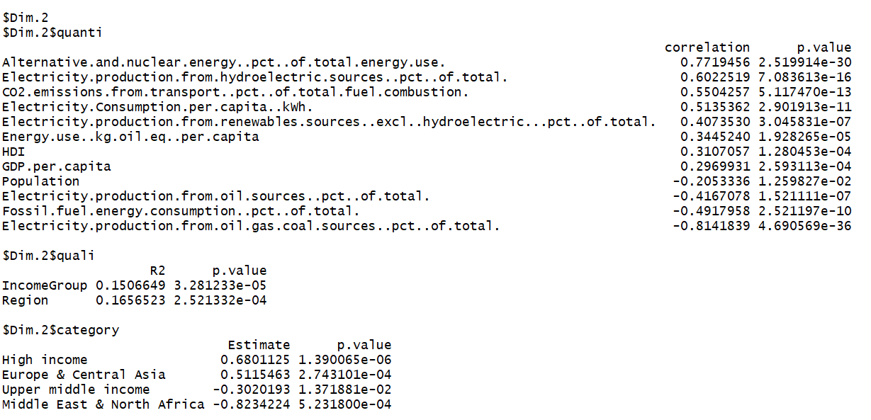

Slide 6
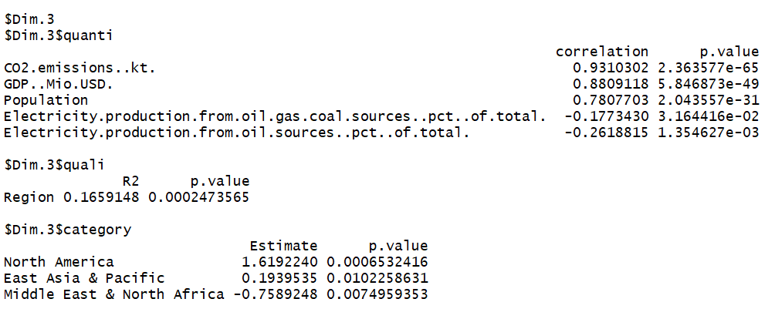

Slide 7
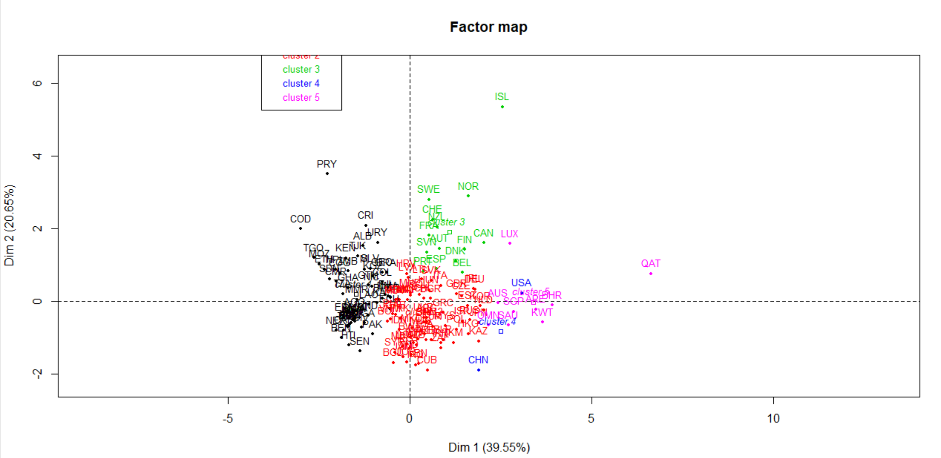

Slide 8
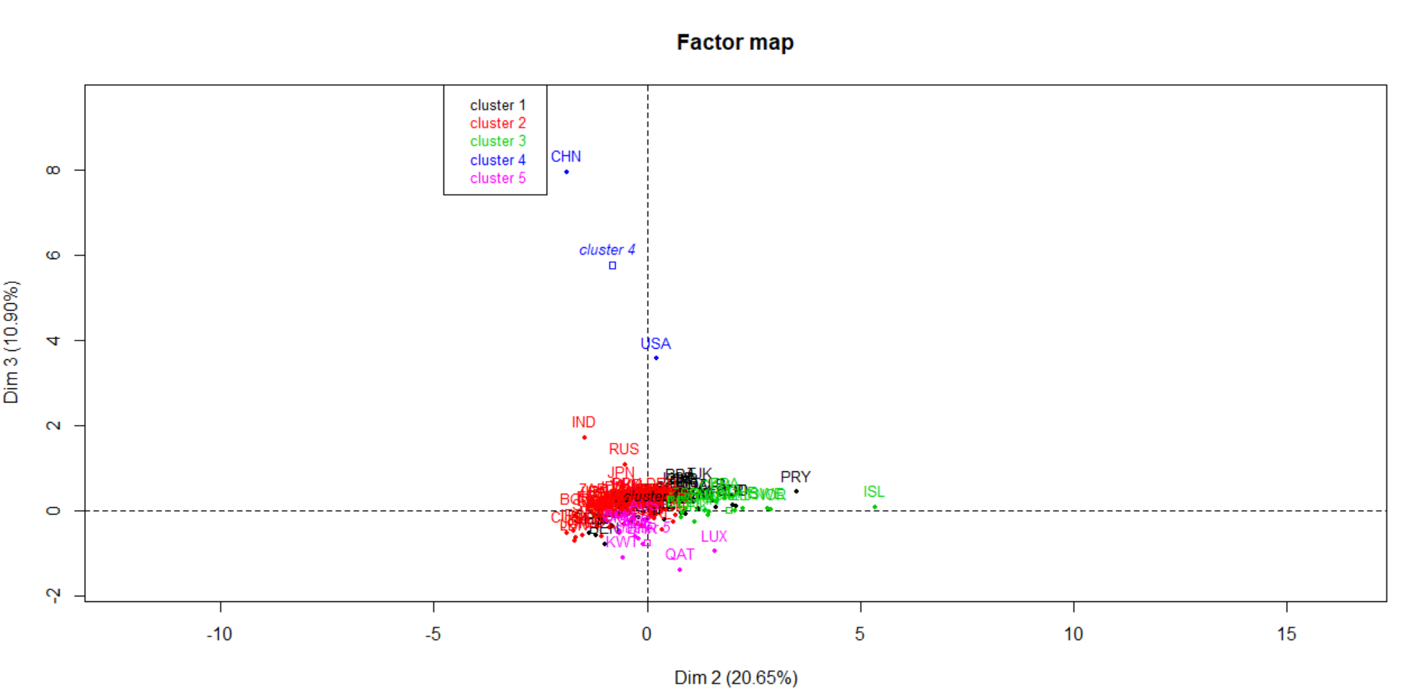

Slide 9
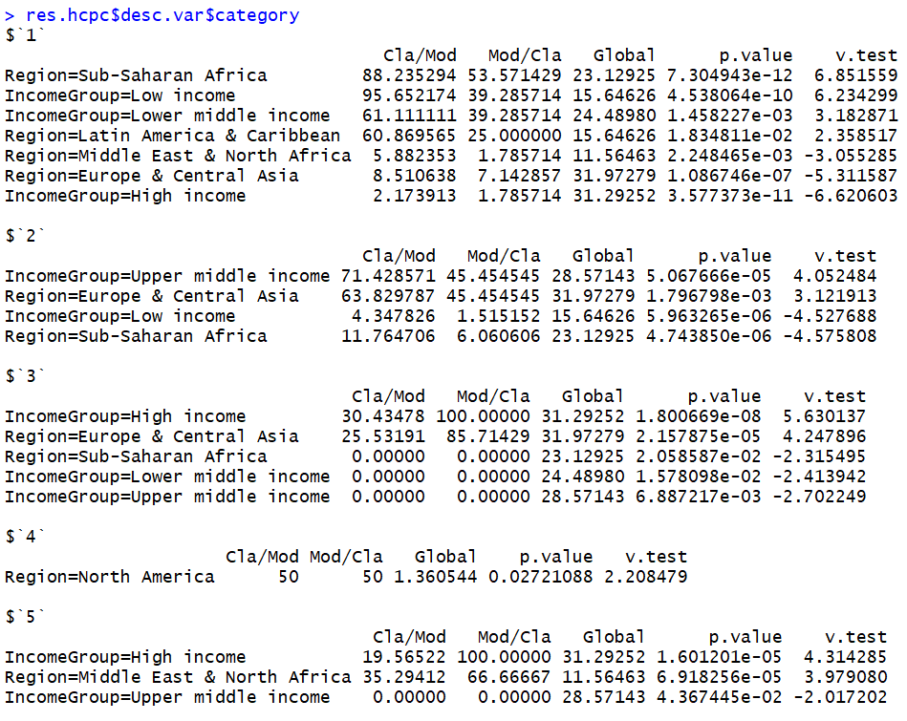

Slide 10


Slide 11


Slide 12
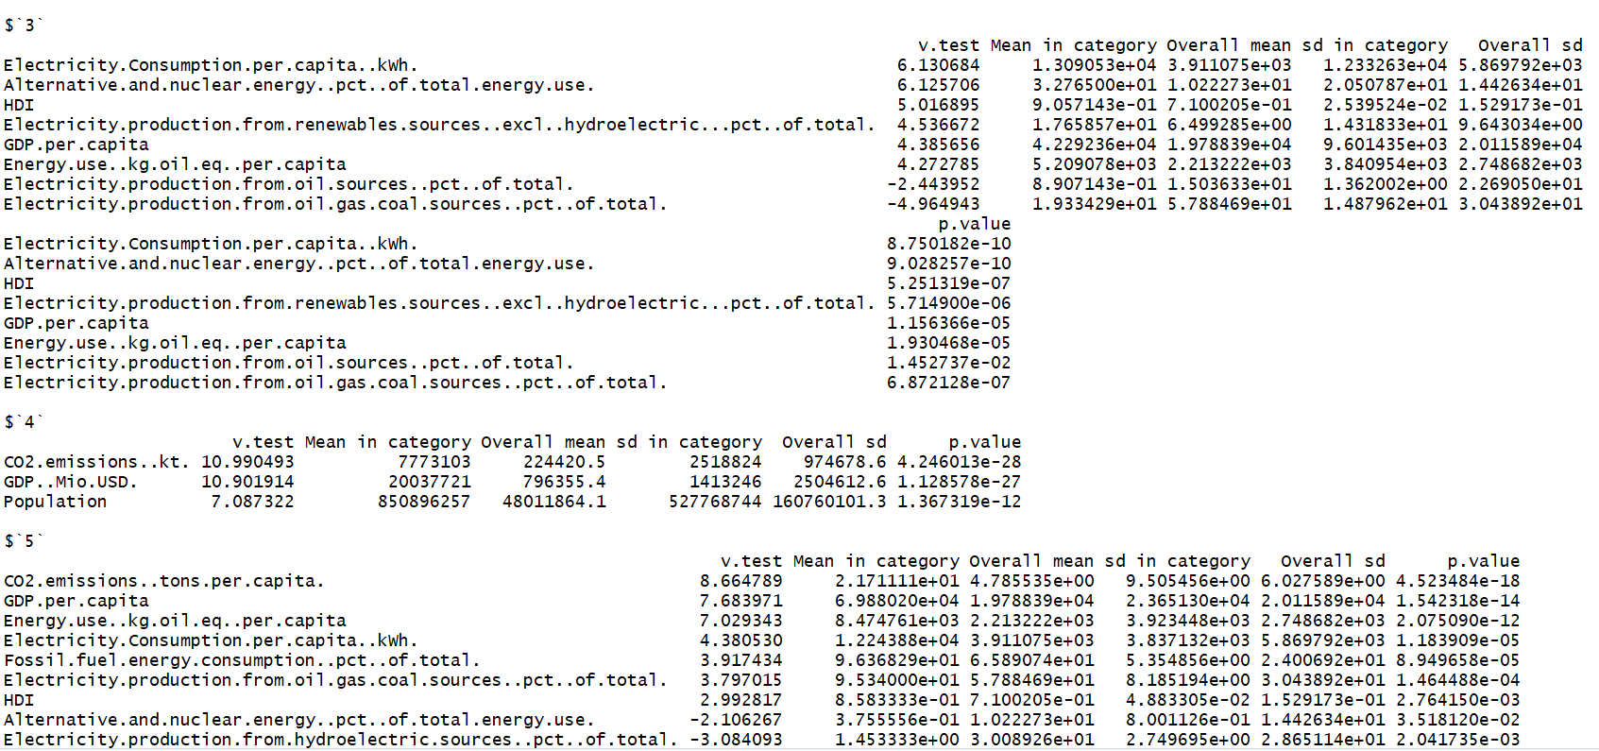

Slide 13
